Slide 1
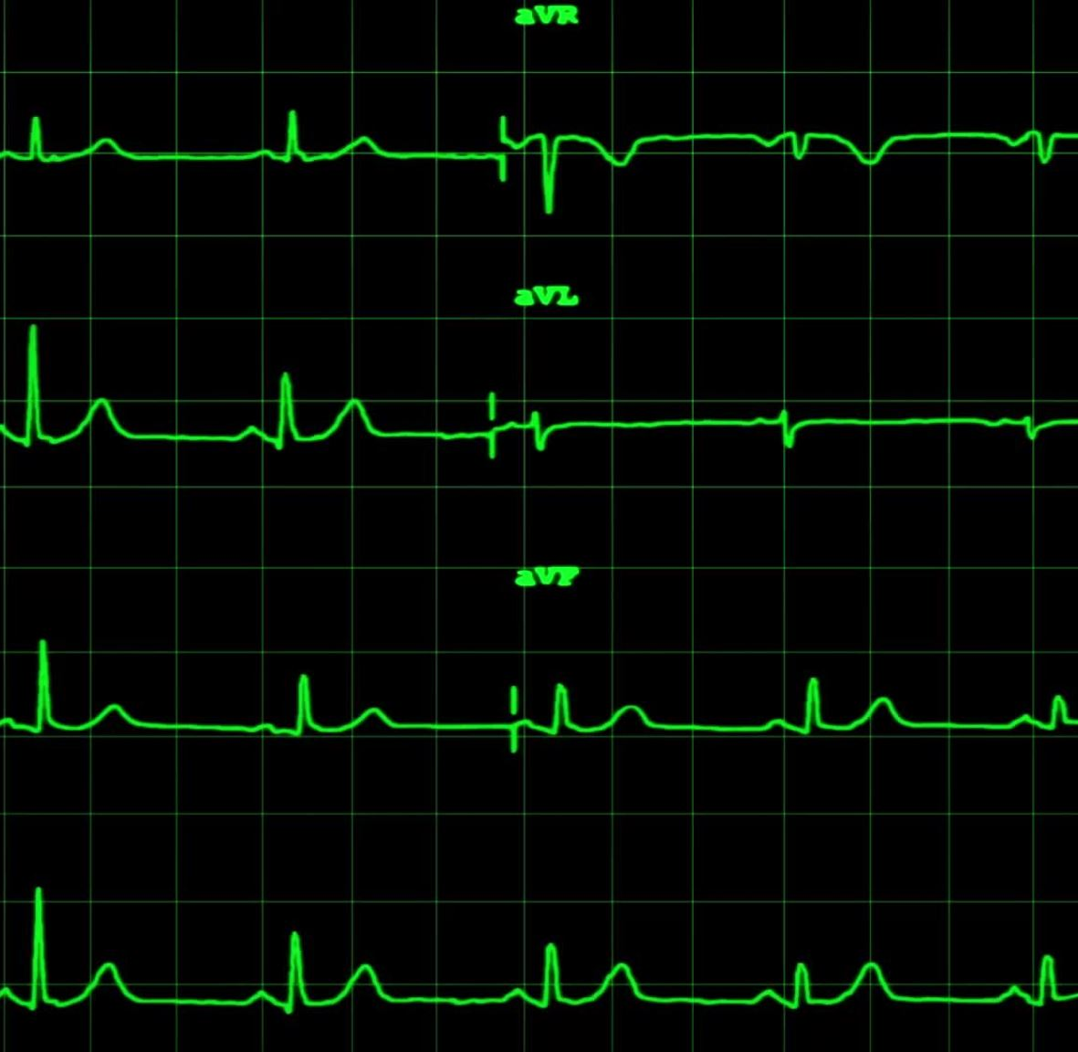
Critical Consciousness in Medicine (CCIM) Facilitator Bootcamp
Elysia James, MD, Sharon T. Thomas, MD
Health Equity Curriculum Committee
UTCOMLS

Slide 2
ICE BREAKER
Name
Specialty
Netflix/Hulu/Cable/other

Slide 3
Objectives
Understand the overview of the UTCOMLS Critical Consciousness in Medicine Curriculum
Provide training for facilitating small group discussions
Notes:
This is due to the feedback from other small group activities where students felt that facilitators were not content experts. You are experts who we want to feel empowered to facilitate these difficult conversations.

Slide 4
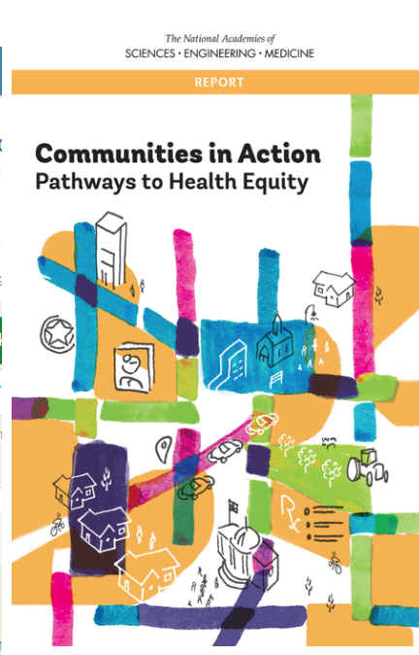
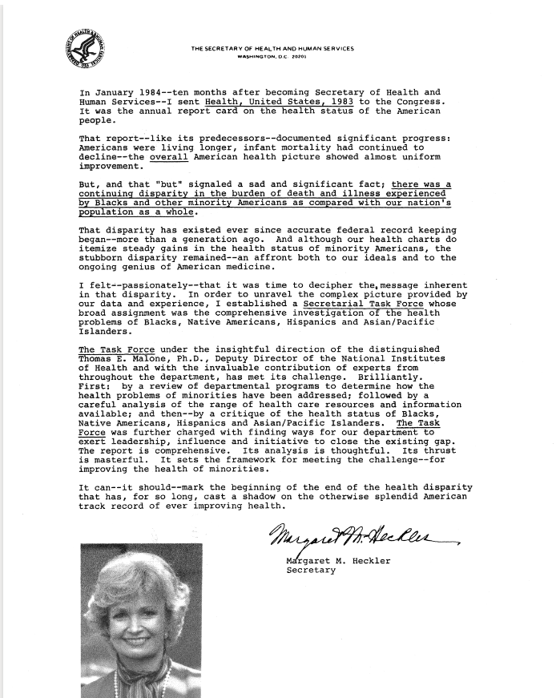
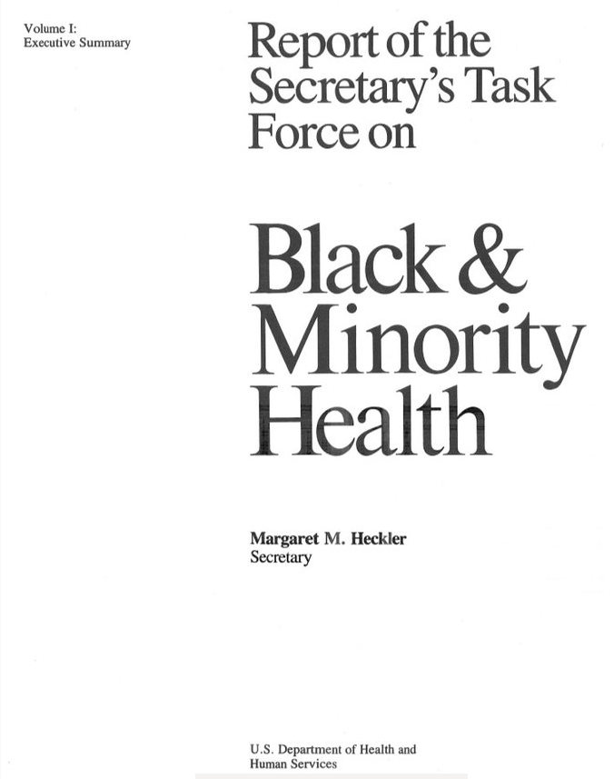

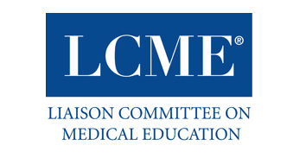
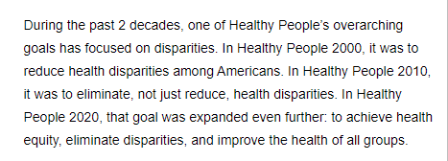
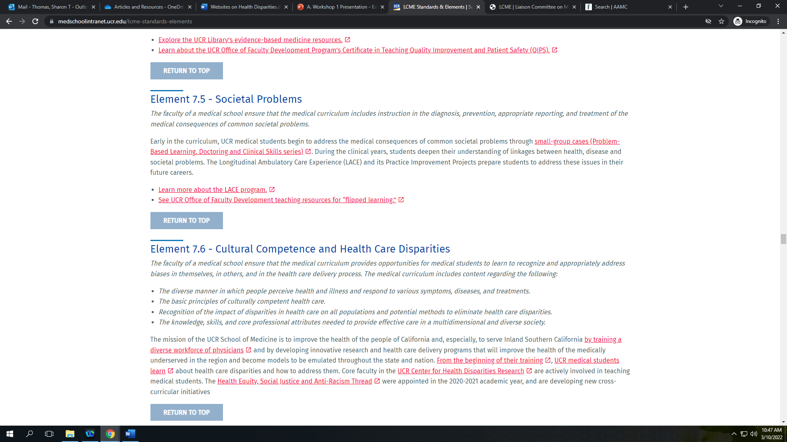
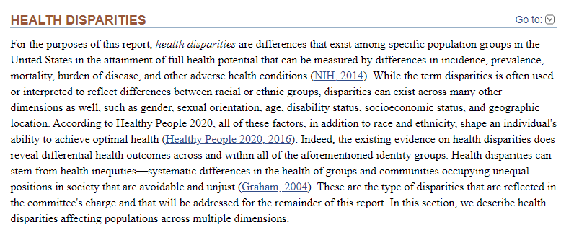
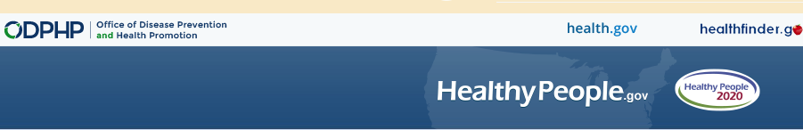
Authors: National Academies of Sciences, Engineering, and Medicine; Health and Medicine Division; Board on Population Health and Public Health Practice; Committee on Community-Based Solutions to Promote Health Equity in the United States. Editors: Alina Baciu, Yamrot Negussie, Amy Geller, and James N. Weinstein.
Washington (DC): National Academies Press (US); 2017 Jan 11.
k to add text

Slide 5
About the UT CCIM Curriculum
LCME requirements require accredited institutions to specifically integrate health equity into the existing medical school curriculum.
  Building additionally on historical GQ surveys, faculty feedback, LCME accreditation feedback.
Completed an extensive literature search including multiple databases (i.e. PubMed and MedEd portal) for health equity curricula and best practices in medical education.
Adopted the curriculum developed by LSU for first year medical students.
Opportunities Abound
  Address health equity with our students during the clinical curriculum.
  Engage multiple levels of expertise and training from our UTCOMLS faculty and residents.

Slide 6
What is Critical Consciousness?
From the work of Paulo Freire
"Critical consciousness posits that the thinking subject does not exist in isolation but, rather, in relationship to others in the world. The development of critical consciousness involves a reflective awareness of the differences in power and privilege and the inequities that are embedded in social relationships."
Kumagai, A.K. and Lypson, M.L. (2009) Beyond cultural competence: Critical consciousness, social justice, and multicultural education. Academic Medicine, 84:6(782-786).

Slide 7
“Critical Consciousness as a Framework for Health Equity Focused Peer Learning”
5 Workshops
M3
Bridge to Clerkship
Intersession 1
Intersession 2
M4
Advanced Clinical Care (ACC) 1
ACC 2

Slide 8
CCIM Workshops
Workshop 1 – Introduction and Identity
Workshop 2 – Identity and Interpersonal Relationships
Workshop 3 – Privilege
Workshop 4 – Health Disparities
Workshop 5 – Implicit Bias and Synthesis

Slide 9
Workshop Ground Rules
Confidentiality
  Avoid disclosing names
Maintain a BRAVE space for discussion and learning
Respect your peers
Be fully engaged
  Phones away
  Laptops closed
Wait your turn to speak
  One person speaks at a time
Participation is encouraged, but you also have the right to pass
Step up
  Both listening and speaking
Incident Reporting
  Utoledo.edu/report
Move on
  We may not be able to fully resolve everything
  Engage with ambiguity and discomfort
  Outside learning is encouraged
Notes:
Utoledo.edu/report
Brave space – provide clinical example. Leaning into the brave space is important in clinical practice (dying patient, cancer diagnosis etc.)

Slide 10
Brave Space
"Learning necessarily involves not merely risk, but the pain of giving up a former condition in favor of a new way of seeing things."
Further Considerations
Agree to disagree
Don't take things personally
  - HALT – Hungry, Angry, Lonely, Tired
Challenge by choice
Respect
No attacks
Arao, B., Clemens, K., (2013). From Safe Spaces to Brave Spaces: A New Way to Frame Dialogue Around Social Justice. In Landreman, L, (Ed.), The Art of Effective Facilitation: Reflections from Social Justice Educators (pp. 135-150). Stylus Publishing.

Slide 11
What is Facilitation?
Workshop facilitation is about helping a group to gain skills and knowledge. Unlike the stereotype role of a school teacher, it's not about being in charge. You don't even need to be an expert in the workshop topic (although it can often help). The key to good facilitation is that you and the participants are equals - you all share responsibility to create a good learning experience.
https://www.seedsforchange.org.uk/facilitatingworkshops

Slide 12

3 Myths about Facilitation
Myth #1: You need to come up with the best solution if you're the facilitator.
  Be the guide, not the hero.
Myth #2: The facilitator needs to be a subject matter expert.
  This is more about the critical thinking process.
Myth #3: You need to be an extrovert to be a good facilitator.
  The group members, NOT you should be doing most of the talking.
  https://www.workshopper.com/post/the-ultimate-guide-to-facilitation

Slide 13
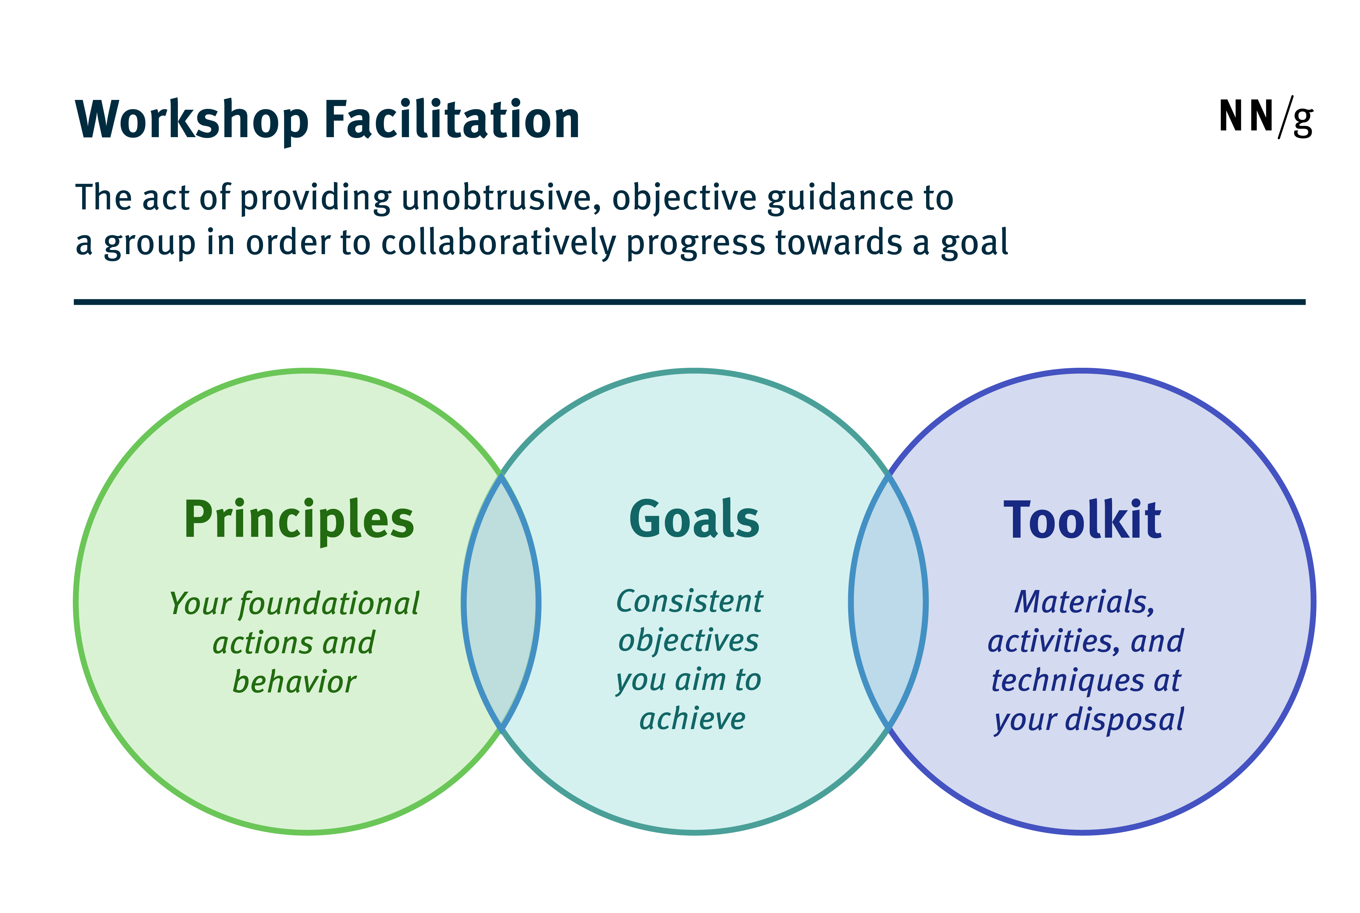
A Useful Framework for Facilitation
https://www.nngroup.com/articles/workshop-facilitation-101/

Slide 14
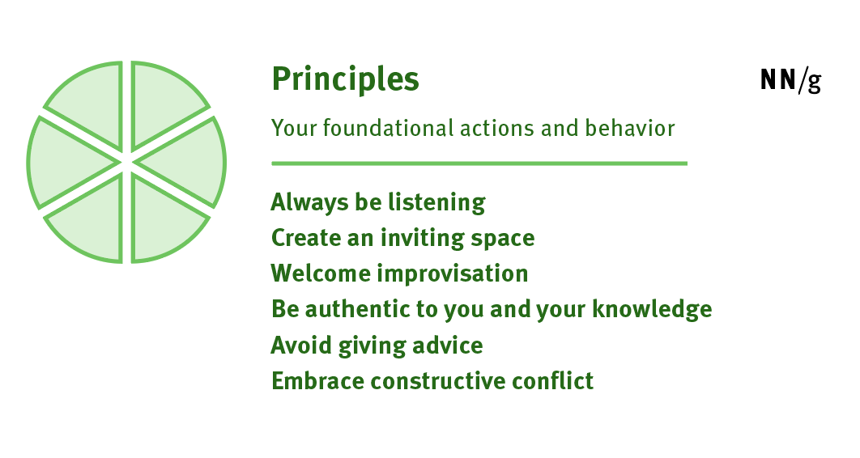
https://www.nngroup.com/articles/workshop-facilitation-101/

Slide 15
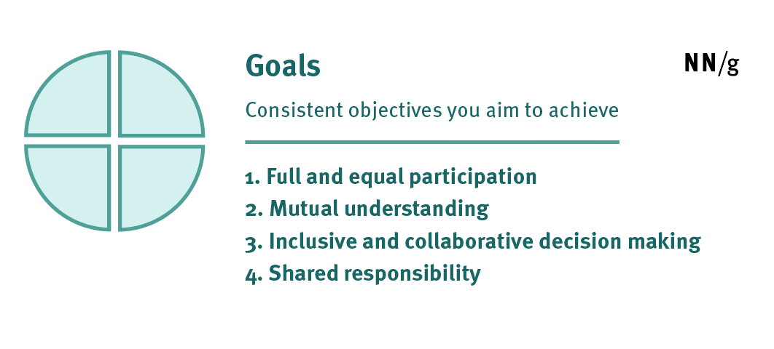
https://www.nngroup.com/articles/workshop-facilitation-101/

Slide 16
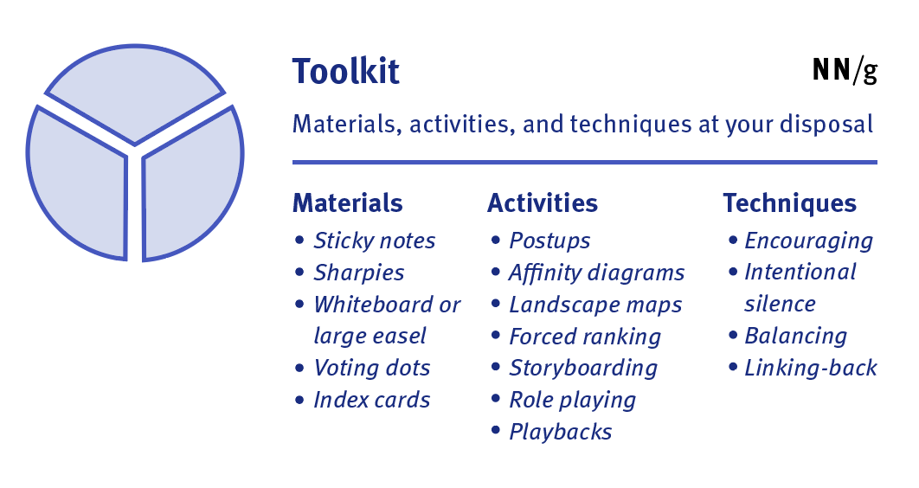
https://www.nngroup.com/articles/workshop-facilitation-101/

Slide 17
Tips For Getting Started
Once separated into smaller groups, introduce yourself.
Start with group member introductions and an ice breaker to help everyone settle into the group and become a little more comfortable.
  Example: Have everyone introduce themselves with name and favorite ice cream flavor/Ohio season/favorite food/animal etc.
Write down everyone's names/pronunciation for yourself so you can be specific in your identification of individuals during the conversation.
Establish what your role will be during the discussion.
Notes:
Put an ice breaker in each facilitator guide.

Slide 18
Guiding Principles
Cognitive dissonance: psychological discomfort resulting from incongruous beliefs and attitudes held simultaneously.
  growth may occur when one encounters an experience, idea, perspective, or identity with which one is unfamiliar.
Critical reflection: analysis of personal assumptions, biases, values, and perspectives.
Critical consciousness: an awareness of the self, others, and the world and a commitment to addressing issues of societal relevance in health care.
Kumagai, A.K. and Lypson, M.L. (2009) Beyond cultural competence: Critical consciousness, social justice, and multicultural education. Academic Medicine, 84:6(782-786).
Notes:
Define cognitive dissonance – Mental discomfort that occurs when one holds conflicting beliefs, attitudes, or values. When people encounter inconsistencies between their beliefs and behavior, they engage in attempts to alleviate the mental discomfort. This often occurs in the form of rejecting, explaining away, or avoiding new information.
Critical reflection – emphasize that this is a very important practice in medicine as the same process makes one a better clinician.

Slide 19
Workshop 1: Introduction and Identity
Learning Objectives
Describe the scope and sequence of this workshop series, how it fits into the medical school curriculum and its importance alongside clinical training.
Identify the guiding principles of this workshop series.
Begin to critically self-reflect on one’s individual identity and its role in shaping perspective.
Notes:
Outline of the learning objectives for this session.

Slide 20
Workshop 2: Identity and Interpersonal Relationships
Learning Objectives
Recognize the ways in which individual identity shapes person to person (interpersonal) interactions in medical education and healthcare.
Identify your own value system and reflect on your values and how they may evolve over the course of your medical education and career.
Identify how a physician’s values can shape their decision making.
Notes:
This slide lists learning objectives for this session.

Slide 21
Workshop 3: Privilege
Learning Objectives
Identify 1-3 types of privilege that we ourselves actually have.
Identify the ways that privilege interferes with colleague-colleague and doctor-patient communication and understanding.
Identify a strategy to explore someone else’s perspective on privilege.
Notes:
This slide lists the learning objectives for this workshop.

Slide 22
Workshop 4: Health Disparities
Learning Objectives
Identify two examples of health disparities in U.S. society.
Analyze the historical context and structural factors that contribute to present-day health disparities.
Recognize the opportunity that medical students and physicians have to work on addressing health disparities.
Notes:
Learning objectives for today’s session.

Slide 23
Workshop 5: Implicit Bias and Synthesis
Learning Objectives
Discuss the Implicit Association Test (IAT) as a tool for surfacing implicit bias.
Identify instances of implicit bias in medical education and health care.
Apply an understanding of implicit bias to reflect on ways to address our own biases.
Synthesize learning from across CCM workshops and develop a plan for future learning.
Notes:
Learning objectives for today’s session.

Slide 24
Workshop Format
Large group format to establish shared concepts and language.
Small group work – combination of individual activities, pair/share and small group.

Slide 25
Small Group Work
Facilitators are key in the success of these conversations
You will receive a guide ahead of time to know what to expect in terms of subject matter and activities.

Slide 26

Now for some practice...
Notes:
<div style="white-space:nowrap;"><a target="PantherMedia" href="https://stockagency.panthermedia.net/m/stock-photos/26988204/multi-ethnic-people-sitting-in-circle/?utm_source=Backlink&utm_medium=Link&utm_content=Detail&utm_campaign=Backlink-Optional" rel="bookmark">&copy; PantherMedia Stock Agency </a>&nbsp;/&nbsp;<a target="PantherMedia" href="https://stockagency.panthermedia.net/u/media/AndreyPopov?q=&utm_source=Backlink&utm_medium=Link&utm_content=User&utm_campaign=Backlink-Optional" rel="author">Andriy Popov<

Slide 27
Small Group Activity
Workshop 1 Activity

Slide 28
What if?......
Let's practice dealing with some possible scenarios given that we are discussing difficult topics.

Slide 29
Case 1
You are facilitating a group of 15 eager medical students. About 10 minutes into the conversation, you notice that 3 of the students, are doing most of the talking. They are completely dominating the conversation. Some of the other students are starting to look disengaged. What should you do?

Slide 30
What should you do?
Acknowledge your own thoughts/feelings
Toolkit – helpful or not?
Difficult Conversation experience

Slide 31
https://www.nngroup.com/articles/workshop-facilitation-101/

Slide 32
Case 2
Your group members are discussing where they are from. Carly mentions that she is from a very small town that did not have any diversity. Another student, Sam comments that Carly must really need this course since she won't know how to deal with people who aren't like her. Several other students, some of whom are underrepresented minorities nod in agreement. What should you do?

Slide 33
What should you do?
Acknowledge your own thoughts/feelings
Toolkit – helpful or not?
Difficult Conversation experience

Slide 34
https://www.nngroup.com/articles/workshop-facilitation-101/

Slide 35
Case 3
While discussing health disparities, you notice that one student Natalie seems visibly upset when a classmate comments on the responsibility of the patient in their own health care outcomes. Natalie angerly replies that her sister died because no one would believe her symptoms because of how she looked not because she didn't seek medical care. The group falls silent after that exchange. What should you do?

Slide 36
What should you do?
Acknowledge your own thoughts/feelings
Toolkit – helpful or not?
Difficult Conversation experience

Slide 37
https://www.nngroup.com/articles/workshop-facilitation-101/

Slide 38
Case 4
Your group is having a lively discussion, but you notice that one student Kyle, has not said a word. You are confident that he could add to the richness of the conversation. What should you do?

Slide 39
What should you do?
Acknowledge your own thoughts/feelings
Toolkit – helpful or not?
Difficult Conversation experience

Slide 40
https://www.nngroup.com/articles/workshop-facilitation-101/

Slide 41

Questions?

